Slide 1


A review based on handling Multithreading using java
Babita Upraity(jv-u/16/9102)
Sonal Verma(jv-i/16/9368)
B.Tech CS

Slide 2
Content
What is Thread
What is Multitasking and Multithreading
States of a thread
Thread Creation
Thread priority
Synchronization
Advantages of Threads
Conclusion

Slide 3
Thread
A Thread is a subset of process
A thread is a single sequential flow of execution with in a program.
Thread is considered as “light weight process” because it uses less resource than process.
JVM creates the thread whose task is to define the main thread

Slide 4
Multitasking and Multithreading
Multitasking
It refer to a computer ‘s ability to perform multiple jobs concurrently .
More than one program are running concurrently e.g..-UNIX
Multithreading
It refers to multiple threads of controls within a single program.
Each program can run multiple threads or control within it e.g. web Browser.

Slide 5
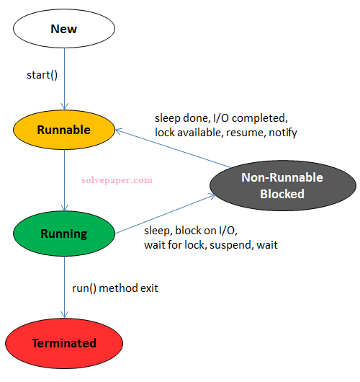
States of thread Life cycle
New-The thread object has been created but has not been initialized.
Runnable- The thread object is ready to run whenever the CPU gives it a time slot.
Blocked- The thread could be run. but is currently not in a runnable state.
Running-The thread is in running state if the thread scheduler has selected it.
Terminated- The thread has terminated.

Slide 6
Thread Creation
Two ways to create our own Thread Object
By extending a thread class.
By implementing a Runnable interface
In both case the run() method should be implemented

Slide 7
Extending thread class
Implementing runnable interface
class Multi extends Thread{
public void run()
{
System.out.println("thread is running...");
}
public static void main(String args[]){
Multi t1=new Multi();
t1.start();
}
}
class Multi3 implements Runnable{
public void run(){
System.out.println("thread is running...");
}
public static void main(String args[]){
Multi3 m1=new Multi3();
Thread t1 =new Thread(m1);
t1.start();
} }

Slide 8
Thread Priority
Every thread has priority
When a thread is created, it inherits the Priority of the thread that created it
The priority values range from 1 to 10 in increasing priority
Priority constant are defined:
MIN_PRIORITY = 1
MAX_PRIORITY=10
NORM_PRIORITY=5

Slide 9
Synchronization
Synchronization in java is the capability of control the access of multiple threads to any shared resource.
Java synchronization is better option where we want to allow only one thread to access the shared resource.
Why we use :
To prevent thread interference.
To prevent concurrency problem.
Synchronized method is used to lock an object for any shared resource.
Java has the equivalent mechanism. It is called synchronization.
Java has a keyword called synchronized.

Slide 10
Example using Synchronized
class MyThread1 extends Thread{
public void run()
{
Synchronized(this)
{
For(int i=0;i<5;i++)
{
System.out.println(Thread.currentThread().getName()+(i));
}
}
}
}
public class TestSynchronization2{
public static void main(String args[])
{
MyThread1 b=new MyThread1();
Thread t1=new Thread(b);
t1.setName(“t1”);
T1.start();
Thread t2=new Thread(b);
T2.setName(“t2”);
T2.start();
}
}

Slide 11
Output
T1:0
T1:1
T1:2
T1:3
T1:4
T2:0
T2:1
T2:2
T3:3
T3:4

Slide 12
Advantages of Multithreading
General: better use of system resources
Simultaneous and parallelized happening of jobs
Reduced cost of cares
Improved use of CPU supply
Better use of cache storage by operation of resources

Slide 13
Conclusion
This module tackled the topic of Multithreaded Java programming. We began the module by learning some basics about multithreading and why threads are important. You examined some practical scenarios where it is necessary to employ threads to improve the structure and performance of programs. We learned how to create and use threads, as well as how to put them asleep. The module also explained how to resolve the tricky issue of thread synchronization.

